Slide 1

CoolTShirts Project
Learn SQL from Scratch
By: Jason Irvine
7/09/2018

Slide 2
Table of Contents
Get Familiar with CoolTShirts
What Is The User Journey?
Optimize The Campaign Budget

Slide 3
1. Get Familar with CoolTShirts

Slide 4
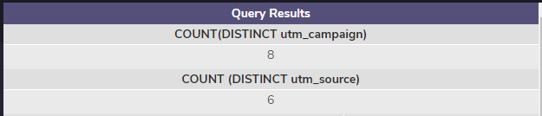
1.1 Get Familar with CoolTShirts
How many campaigns and sources does CoolTShirts use?
To answer this question I used the SQL (right frame)
SELECT COUNT(DISTINCT utm_campaign)
FROM page_visits;
SELECT COUNT (DISTINCT utm_source)
FROM page_visits;

Slide 5
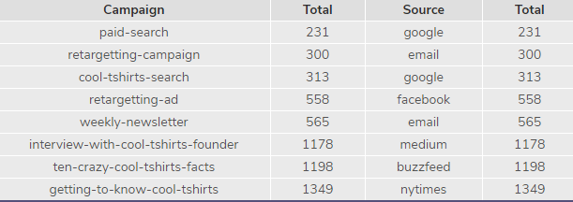
1.2 Get Familiar with CoolTShirts
Which Source is used for each campaign?
To answer the above question I used the SQL(right frame)
Results are below.. Below is a list of the campaigns and sources for CoolTShirts. The results reflect the source used for each campaign and total.
SELECT DISTINCT utm_campaign AS Campaign, COUNT(utm_campaign) AS Total, utm_source AS Source, COUNT(utm_source) AS Total
FROM page_visits
GROUP BY 1
ORDER BY 2;

Slide 6
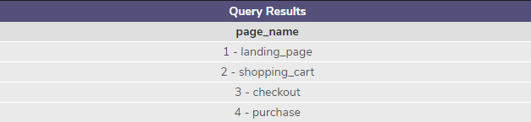
1.3 Get Familar with CoolTShirts
What pages are on the CoolTShirts website?
For this question I used the SQL (right frame)
Results below..
SELECT DISTINCT page_name
FROM page_visits
LIMIT 10;

Slide 7
2. What Is The User Journey?

Slide 8
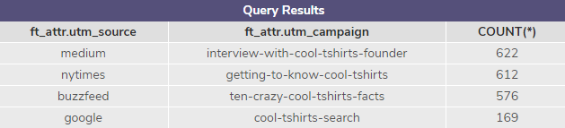
2.1 What Is The Journey
WITH first_touch AS (WITH first_touch AS (
SELECT user_id,
MIN(timestamp) as first_touch_at
FROM page_visits
GROUP BY user_id)
SELECT ft.user_id,
ft.first_touch_at,
pv.utm_source,
pv.utm_campaign
FROM first_touch ft
JOIN page_visits pv
ON ft.user_id = pv.user_id
AND ft.first_touch_at = pv.timestamp),
ft_attr AS (
SELECT ft.user_id,
ft.first_touch_at,
pv.utm_source,
pv.utm_campaign
FROM first_touch ft
JOIN page_visits pv
ON ft.user_id = pv.user_id
AND ft.first_touch_at = pv.timestamp
)
SELECT ft_attr.utm_source,
ft_attr.utm_campaign,
COUNT(*)
FROM ft_attr
GROUP BY 1, 2
ORDER BY 3 DESC;
How many first touches is each campaign responsible for?
To answer this question I used the SQL (right frame)

Slide 9
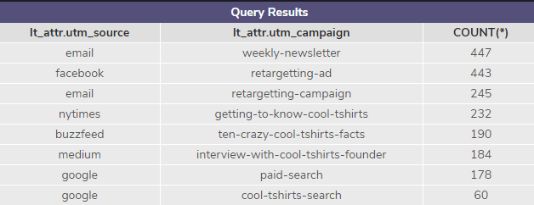
2.2 What Is The Journey?
WITH last_touch AS (WITH last_touch AS (
SELECT user_id,
MAX(timestamp) as last_touch_at
FROM page_visits
GROUP BY user_id)
SELECT lt.user_id,
lt.last_touch_at,
pv.utm_source,
pv.utm_campaign
FROM last_touch lt
JOIN page_visits pv
ON lt.user_id = pv.user_id
AND lt.last_touch_at = pv.timestamp),
lt_attr AS (
SELECT lt.user_id,
lt.last_touch_at,
pv.utm_source,
pv.utm_campaign
FROM last_touch lt
JOIN page_visits pv
ON lt.user_id = pv.user_id
AND lt.last_touch_at = pv.timestamp
)
SELECT lt_attr.utm_source,
lt_attr.utm_campaign,
COUNT(*)
FROM lt_attr
GROUP BY 1, 2
ORDER BY 3 DESC;
How many last touches is each campaign responsible for?
To answer this question I used the SQL (right frame)

Slide 10

2.3 What is The User Journey?
How many visitors make a purchase?
To answer this question I used the SQL(right frame)
Results below..
SELECT DISTINCT COUNT(user_id), page_name
FROM page_visits
WHERE page_name = '4 - purchase';

Slide 11
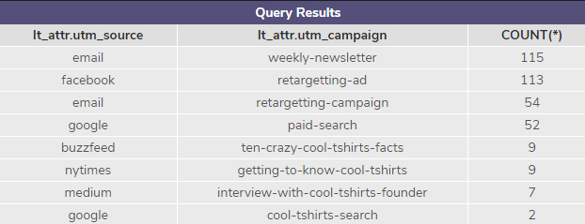
WITH last_touch AS (WITH last_touch AS (
SELECT user_id,
MAX(timestamp) as last_touch_at
FROM page_visits
WHERE page_name = '4 - purchase'
GROUP BY user_id)
SELECT lt.user_id,
lt.last_touch_at,
pv.utm_source,
pv.utm_campaign
FROM last_touch lt
JOIN page_visits pv
ON lt.user_id = pv.user_id
AND lt.last_touch_at = pv.timestamp),
lt_attr AS (
SELECT lt.user_id,
lt.last_touch_at,
pv.utm_source,
pv.utm_campaign
FROM last_touch lt
JOIN page_visits pv
ON lt.user_id = pv.user_id
AND lt.last_touch_at = pv.timestamp
)
SELECT lt_attr.utm_source,
lt_attr.utm_campaign,
COUNT(*)
FROM lt_attr
GROUP BY 1, 2
ORDER BY 3 DESC;
2.4 What is The User Journey?
How many last touches on the purchase page is each campaign responsible for?
To answer this question I used the SQL(right frame)
Results below..

Slide 12
2.5 What Is The Typical Journey?
The typical journey for the user is evenly balanced between
the first touches. The source/campaigns: medium (interview-with-
cool-tshirts-founder), nytimes(getting-to-know-cool-tshirts), and
buzzfeed(ten-crazy-cool-tshirts-facts).
The typical last touches the users made were from the
source/campaign: email (weekly-newsletter), facebook
(regetting-ad), email(retargeting-campaign), and nytimes(getting-to-
know-cool-tshirts).
The last touches that resulted into a purchase is reflected.
The source/campaigns that resulted in the highest last touches
purchased are: email(weekly-newsletter) and facebook (retargeting-
Ad)

Slide 13
3. Optimize The Campaign Budget

Slide 14
What 5 campaigns should CoolTshirts re-invest in and why?
CoolTShirts should re-invest in the 5 campaigns that led to a purchase. CoolTShirts still needs a first impression campaign that leads to a last touch and eventual purchase. I would reinvest in the top 2 first touch campaigns ( “interview-with-cool-tshirts-founder” and “getting-to-know-cool-tshirts”). Since I’m only allowed to pick 5 campaigns I choose the top 2 from the first touches.
My last 3 campaigns I would choose to re-invest are the last touches that led to a purchase (“weekly-newsletter”, “retargeting-ad”, and “retargeting-campaign”.

Slide 15
The End
Thank You

